Slide 1

Traffic Analysis and Severity Prediction
Thinkful Final Capstone
Genesis Taylor

Slide 2
Background
The UK government collects and publishes (usually on an annual basis) detailed information about traffic accidents across the country. This information includes, but is not limited to, geographical locations, weather conditions, type of vehicles, number of casualties and vehicle maneuvers, making this a very interesting and comprehensive dataset for analysis and research.
The data for this project is available on Kaggle as UK Road Safety: Traffic Accidents and Vehicles

Slide 3
Importance of Analyzing Traffic Accidents
Accurately analyzing accidents can help governments to better the safety of their roads and highways.
Identifying high areas of accidents and high areas of accident severity can highlight areas of concern.
It can also be beneficial to insurance companies looking to changer their rates in different areas.

Slide 4
Agenda
The goal of this project is to investigate and determine what causes accidents and what attributes to their level of severity.
Through visualizations and machine learning algorithms, areas of concern will be highlighted, and the seriousness of accidents will be predicted as accurately as possible.

Slide 5
Data Introduction Details
The data for this project is obtained from a user on Kaggle and was composed from information on the United Kingdom’s Government Open Data website.
It consists of two different datasets that contain information from 2005-2017 that were combined on a common field (accident_index).
Vehicle_Information.csv: A file containing information about the vehicles, point of impact, maneuvers made, driver information, etc.
Accident_Information.csv: A file containing details about the accident that include location, junction details, date and time, accident severity, etc.

Slide 6
Research Questions
What are the limitations of the current data?
What things would help this research to be more accurate?
Can we forecast the number of accidents in upcoming years based on the information available?
Who does this project benefit?
Can we create a machine learning algorithm that correctly predicts the severity of accidents?
When do/did the most accidents happen?
How do the available factors contribute to accident seriousness?

Slide 7
Who does this project benefit?
Government Departments of Transportation
Create safer highways
Prevent fatalities
Reduce severity
Educate the public
Insurance companies
Calculate rates by area, age groups, and car types

Slide 8
When do/did the most accidents happen?
The following charts display the number of accidents by year, month, season and day of the week.
The trends for each time period are displayed for analysis and reviews.

Slide 9
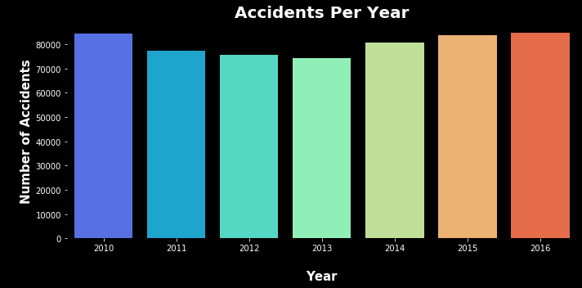
Accidents per Year
According to the graph above, from 2010 to 2013, there was a decrease in the number of accidents, however over the past few years there has been an increase in accidents, with 2016 being close to the 2010 numbers.

Slide 10
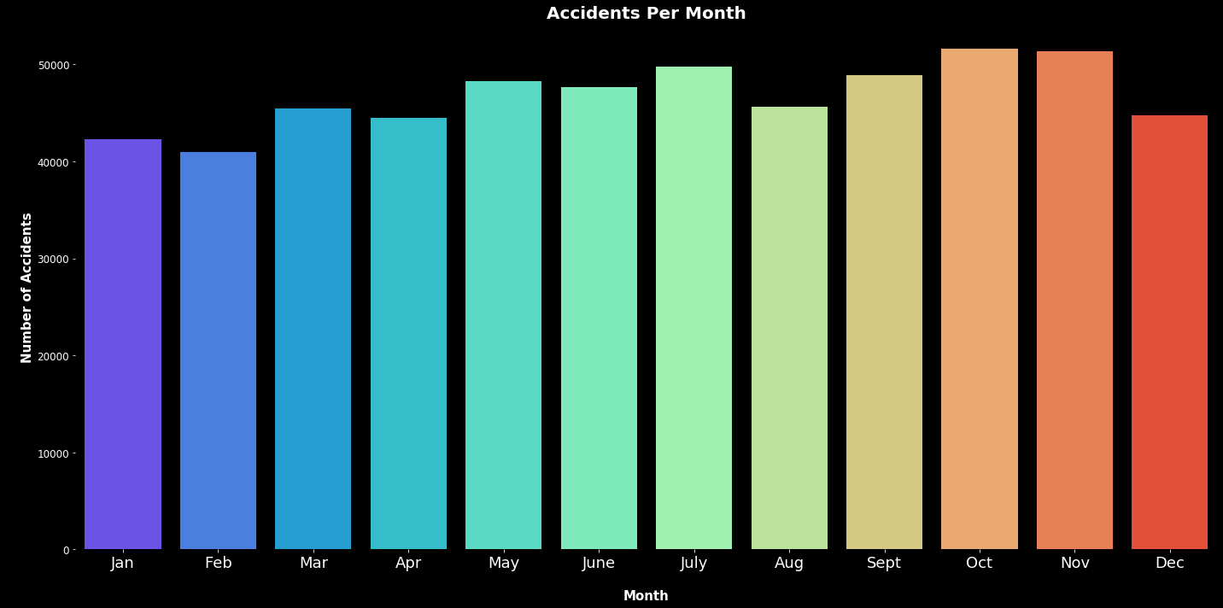
Accidents per Month
According to the graph above, the majority of accidents happen between May and July and September and November.

Slide 11
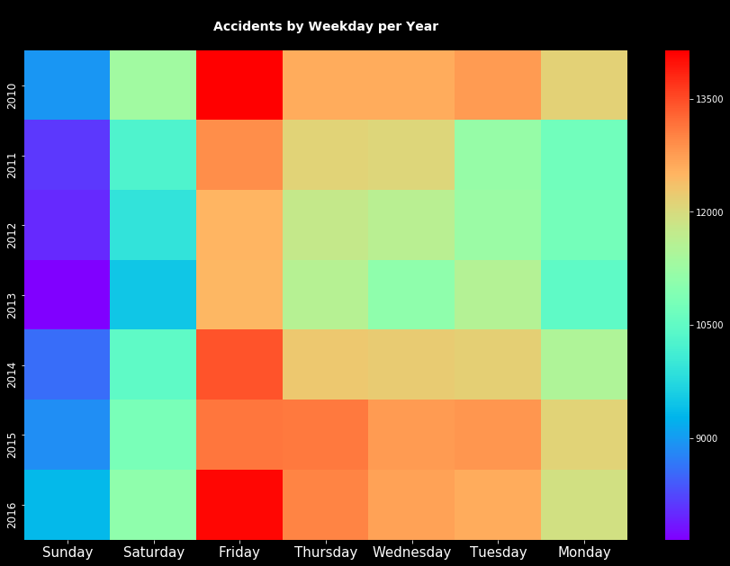
Accidents Per Weekday Per Year
Fridays are the day of the week where the most accidents occur in each year. More information can help to explain this occurrence better.

Slide 12
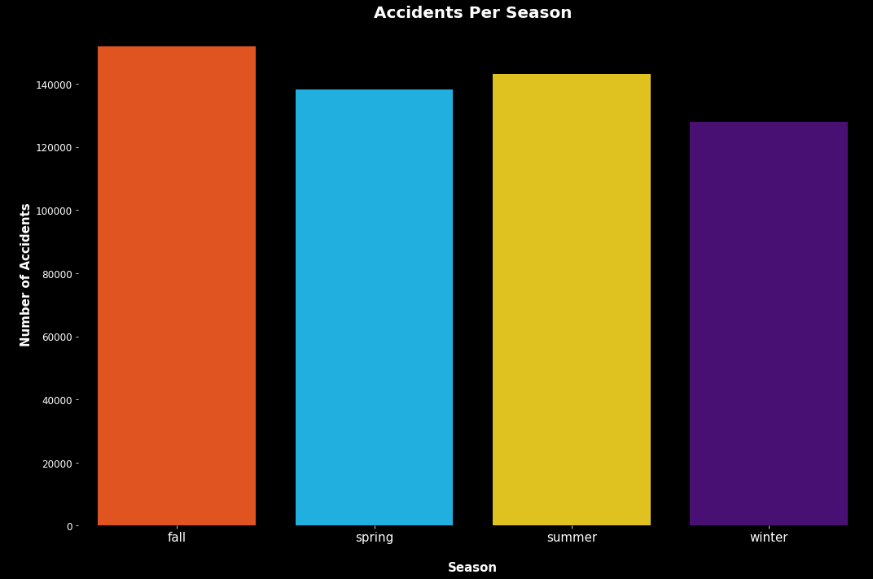
Accidents Per Season
Summer and Fall have the highest number of accidents. These match with the accidents per month and are something for governments to look at closer and compare to whatever events are in the area.

Slide 13
How do the available factors contribute to accident seriousness?
did_police_officer_attend_scene_of_accident
x1st_point_of_impact
number_of_vehicles
speed_limit
urban_or_rural_area
skidding_and_overturning
vehicle_leaving_carriageway
sex_of_driver
vehicle_type
vehicle_manoeuvre
engine_capacity_cc
number_of_casualties
driver_home_area_type
age_band_of_driver
junction_control
hit_object_off_carriageway
hit_object_in_carriageway
driver_imd_decile
junction_detail
junction_location
propulsion_code
year

Slide 14
Did Police Officer Attend Scene Of Accident

Slide 17
Can we create a machine learning algorithm that correctly predicts the severity of accidents?
For machine learning, decision tree and ensemble methods through sklearn will be used, and from them the best performing method will be implemented.
The methods tested are:
Decision Tree
Extra Trees
Random Forest
Bagging
AdaBoost
Gradient Boost
XGBoost
Light GBM
CatBoost

